Slide 1


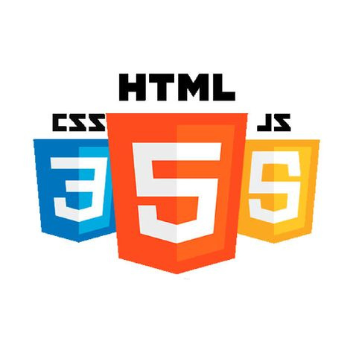

Minders’ 25
FrontEnd
WorkShop
Session five

Slide 2



Table of contents
01
04
JavaScript Overview
Functions
02
05
Variables & Data Types
Objects
06
03
Operators & conditions
Loops

Slide 3
00
What is JavaScript?
The programming language of the web.
Can update and change both HTML and CSS
Foundation for frameworks like React and Angular

Slide 4

Why JavaScript?
Convert the website from static into dynamic
Adds interactivity to websites
Change HTML Attribute Values
Change HTML Styles (CSS)
But How?

Slide 5
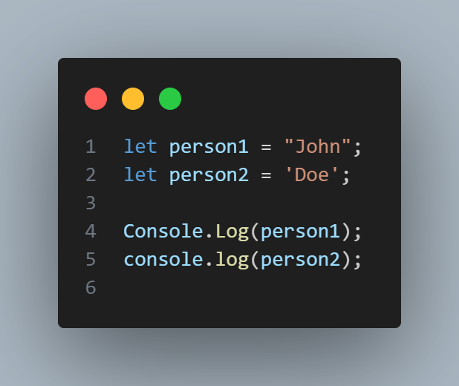
01
Syntax Basics
Semicolons ; to end statements
Case-sensitive language
Curly braces {} define code blocks
How can I view the output of console.log() in JavaScript?

Slide 6
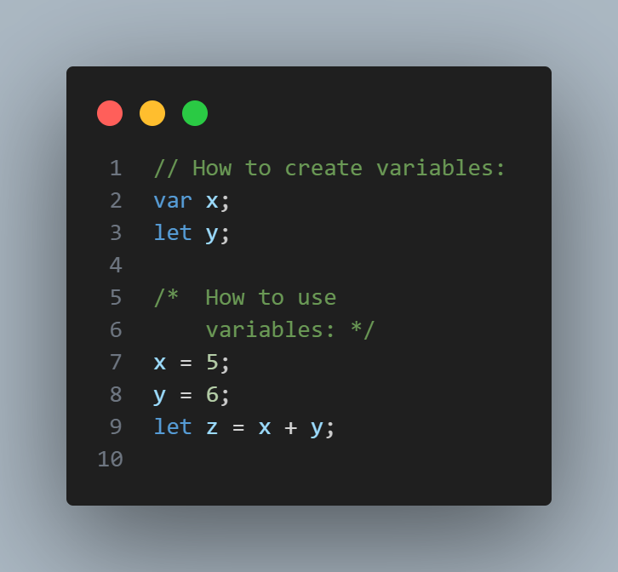

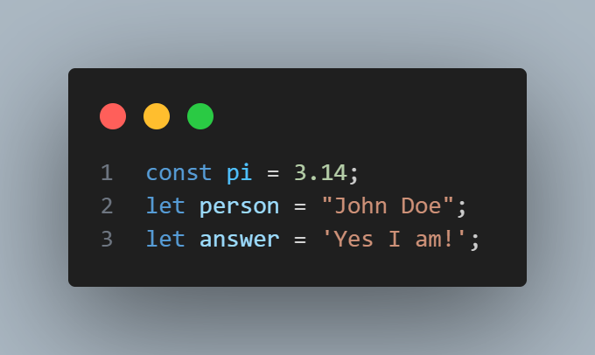
02
Variables
Variables can be declared in 4 ways:
Automatically
Using var
Using let
Using const
What do you think the meaning of automatically?

Slide 7

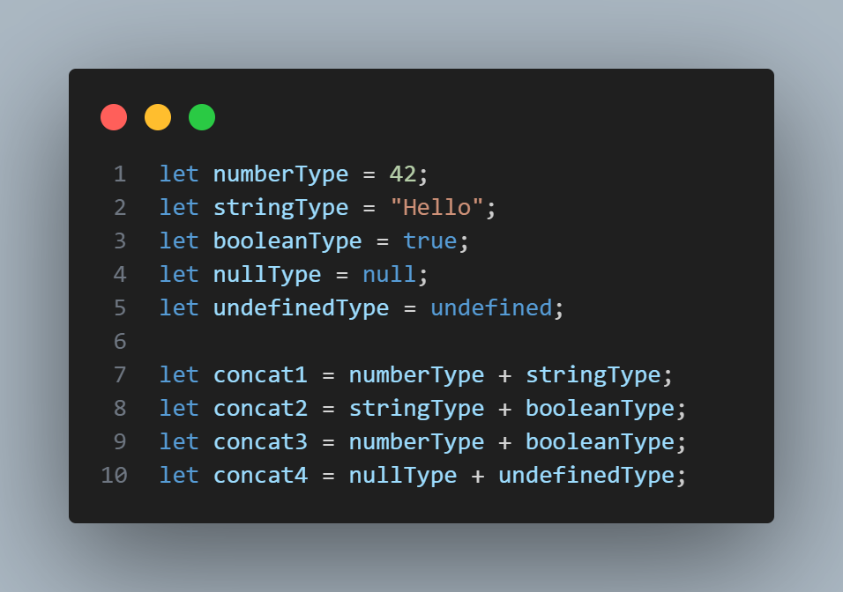
02
Data Types
JavaScript has 8 data types:
String
Number
Bigint
Boolean
Undefined
Null
Symbol
Object
What do you think about the Object data type?

Slide 8
02
Question:
What is the difference between null and undefined?
Null is an explicit value assigned to a variable to represent the intentional absence of any object value or a variable that is intentionally empty.
Undefined means a variable has been declared but has not been assigned a value yet, or a function does not return a value.

Slide 9
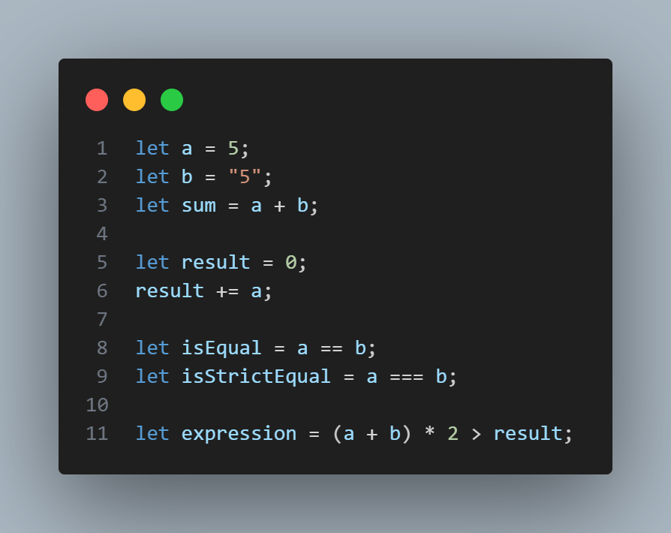
03
Operators & Conditions
Arithmetic: +, -, *, /, %, **
Assignment: =, +=, -=, *=, **=
Comparison Operators: ==, ===, !=, !==, >, <, >=, <=, ?
Logical Operators: &&, ||, !
Operator Precedence:
* ⟶ / ⟶ - ⟶ +

Slide 10
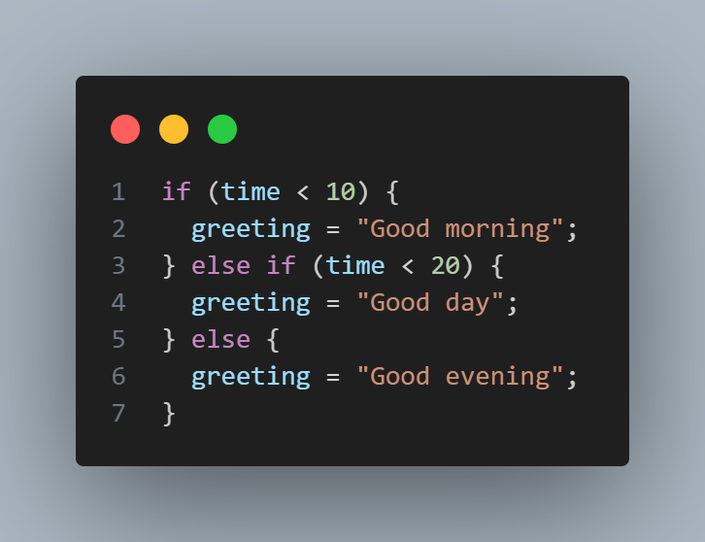
03
Conditions

Slide 11

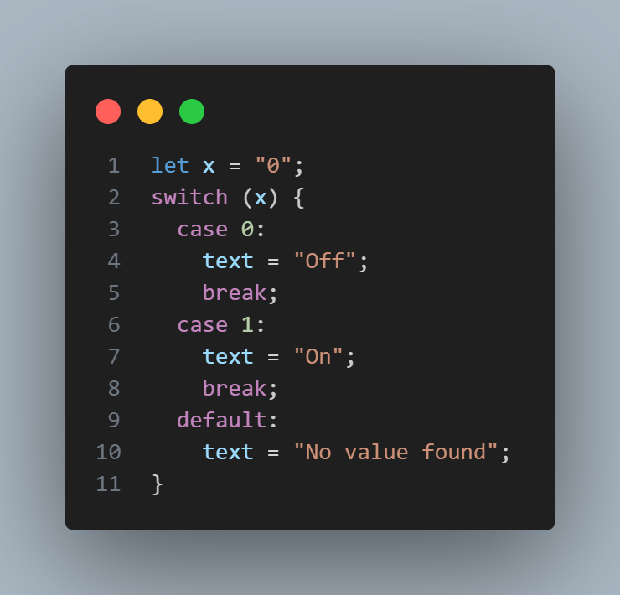
03
Conditions
Switch Statement:
If multiple cases matches a case value, the first case is selected.
If no matching cases are found, the program continues to the default label.
If no default label is found, the program continues to the statement(s) after the switch.
What do you think the output of the following code will be?
Switch cases use strict comparison (===).

Slide 12
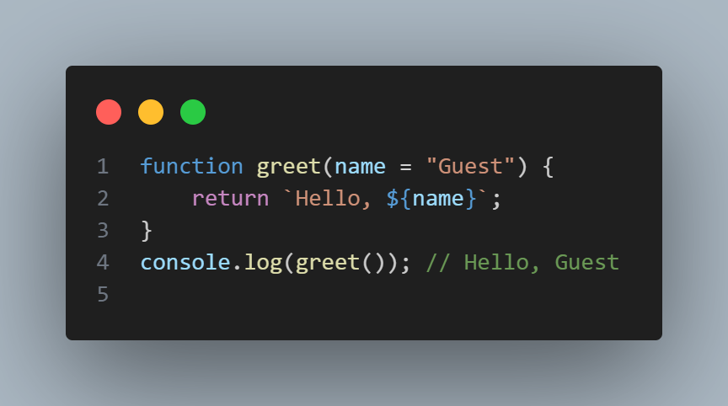
04
Functions
How to define a function?
Default Parameters
defined with the function keyword, followed by a name, followed by parentheses ().

Slide 13
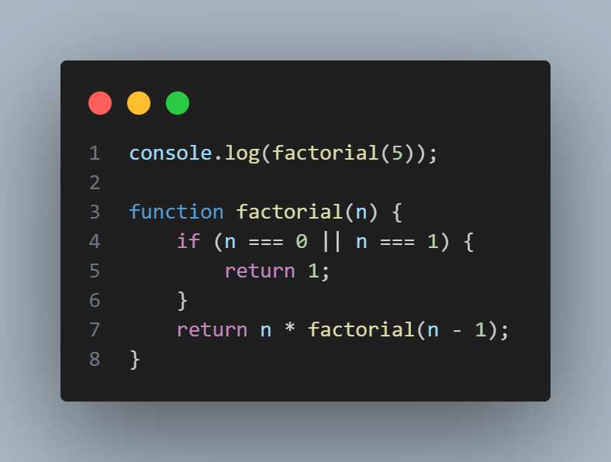
04
Functions
Do you think this is legal?

Slide 14
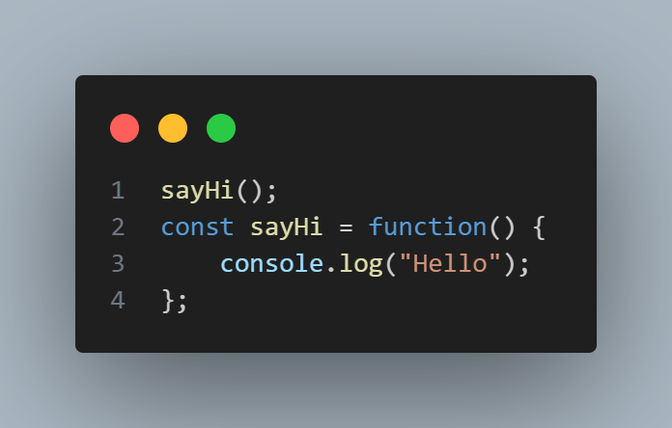
04
Functions
What about this?
JavaScript doesn’t hoist function expressions like it does with declarations.
So sayHi is not defined at the time you try to call it.

Slide 15
04
Functions
A function is a block of code that performs a specific task.
You write it once and then reuse it whenever you need.

Slide 16
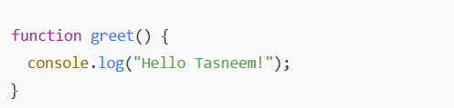

04
Functions
1. Function Declaration:

Slide 17
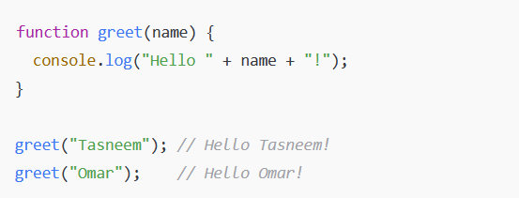
04
Functions
2. Function with Parameters:

Slide 18
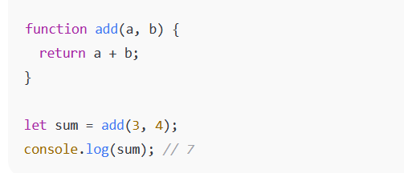
04
Functions
3. Function with Return:

Slide 19
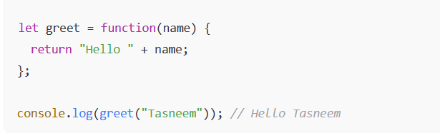
04
Functions
4. Function Expression:

Slide 20
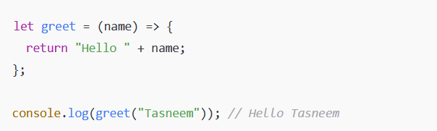
04
Functions
5. Arrow Function (shorter syntax):

Slide 21
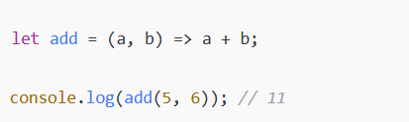
04
Functions
Shortcut (if one line):

Slide 22
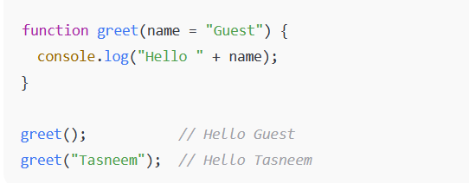
04
Functions
Parameters
Default Parameters:

Slide 23
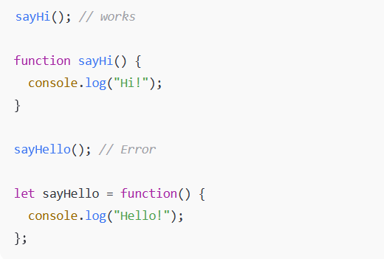
04
Functions
Declaration vs Expression
Declaration functions are hoisted (you can call them before they are defined).

Slide 24
04
Functions
Declaration vs Expression
Expression functions are not hoisted.

Slide 25

Time For Task
Create a "Guess the Number" game where the computer picks a random number between 1 and 10, and the player tries to guess it. Use conditions to check the guess and a function to handle the game logic.
Hint: Create a simple function to check on user input if it matches the guessed number from 1-10

Slide 26
05
Objects
An object is a special data type in JavaScript that allows you to store related information together in the form of key–value pairs.
Key → always a string (or Symbol).
Value → can be anything (string, number, array, another object, or function).

Slide 27
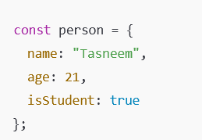
05
Objects
name → key, "Tasneem" → value
age → key, 21 → value
isStudent → key, true → value

Slide 28
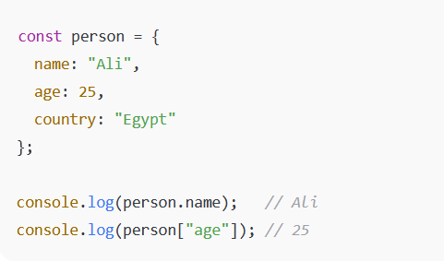
05
Objects
Ways to Create Objects
1. Object Literal (most common)

Slide 29
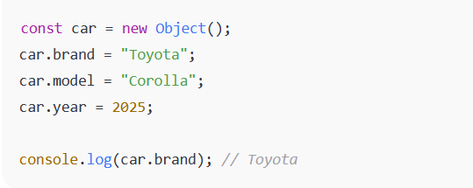
05
Objects
Ways to Create Objects
2. Using new Object()

Slide 30
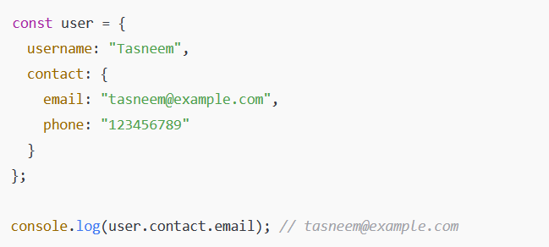
05
Objects
Ways to Create Objects
3. Nested Objects

Slide 31
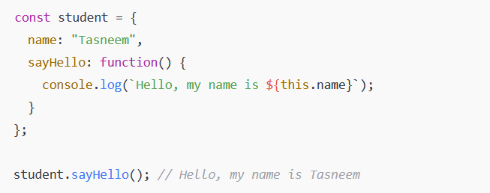
05
Objects
Ways to Create Objects
4. Objects with Methods (functions inside objects)

Slide 32
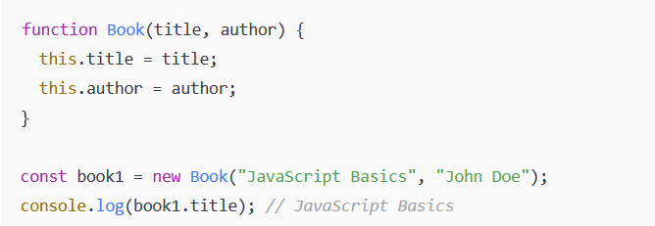
05
Objects
Ways to Create Objects
5. Using a constructor function

Slide 33
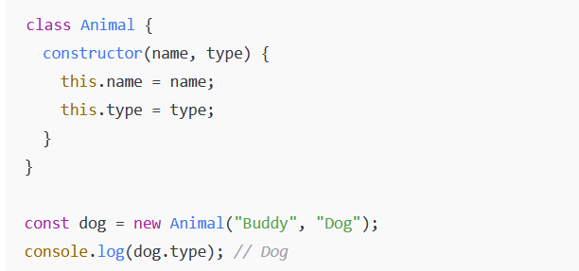
05
Objects
Ways to Create Objects
6. Using a class

Slide 34

05
Objects
Accessing Object Properties
Dot Notation

Slide 35

05
Objects
Accessing Object Properties
Bracket Notation (useful when property is dynamic)

Slide 36
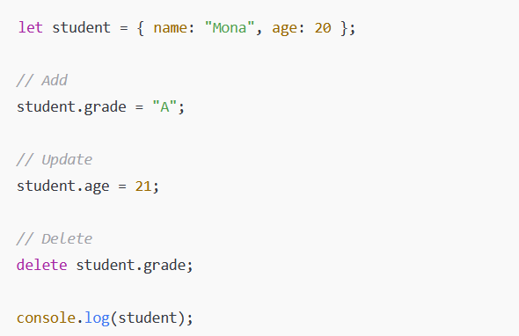
05
Objects
Adding, Updating, Deleting Properties

Slide 37
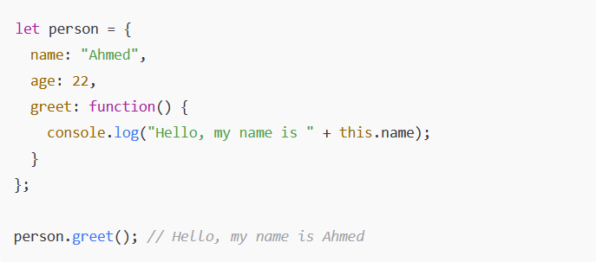
05
Objects
Objects and Methods (this keyword)

Slide 38
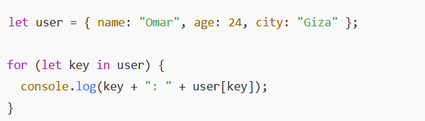
05
Objects
Looping through Objects

Slide 39
05
Objects
Task one

Slide 40
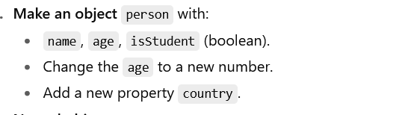
05
Objects
Task Two

Slide 41
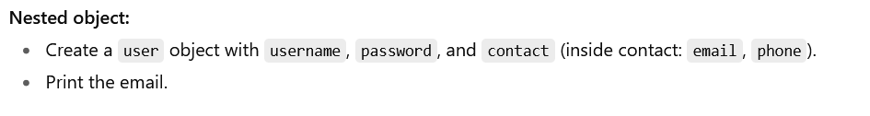
05
Objects
Task Three

Slide 42
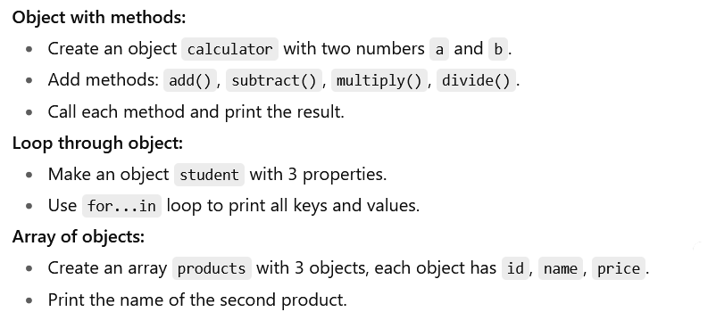
05
Objects
Assignment

Slide 43
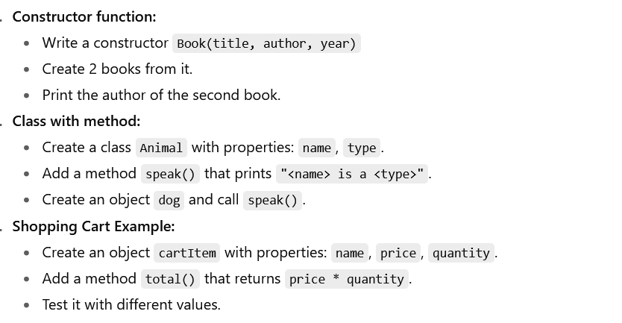
05
Objects
Assignment

Slide 44
06
Loops
A loop is a way to repeat a block of code multiple times until a certain condition is met. Loops help avoid writing repetitive code.

Slide 45
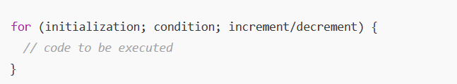
06
Loops
1.For Loop
Best when you know how many times you want to run the loop.

Slide 46
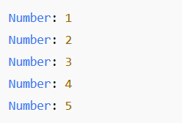
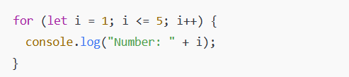
06
Loops
1.For Loop

Slide 47
06
Loops
1.For Loop
initialization → runs once before the loop starts (let i = 1)
condition → loop runs as long as this is true (i <= 5)
increment/decrement → changes the loop variable (i++)

Slide 48
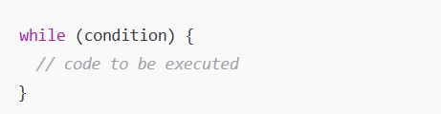
06
Loops
2. While Loop
Best when you don’t know exactly how many times the loop should run, but you want it to continue as long as a condition is true.

Slide 49
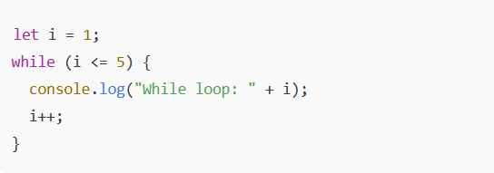
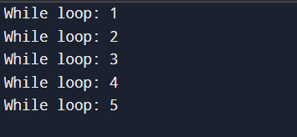
06
Loops
2. While Loop

Slide 50
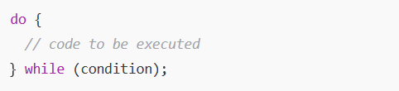
06
Loops
3. Do -While Loop
Similar to while, but the code runs at least once, even if the condition is false.

Slide 51
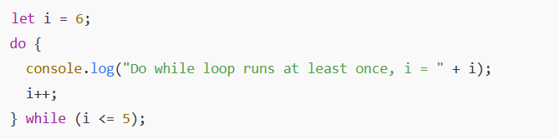
06
Loops
3. Do -While Loop

Slide 52
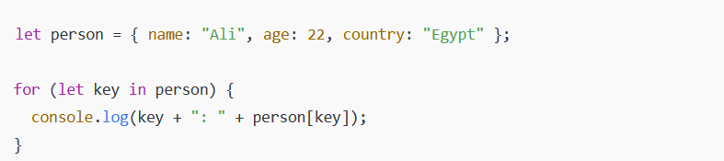
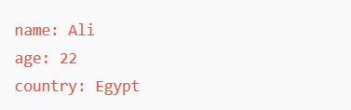
06
Loops
4. for...in loop
Used to loop through the properties (keys) of an object.

Slide 53
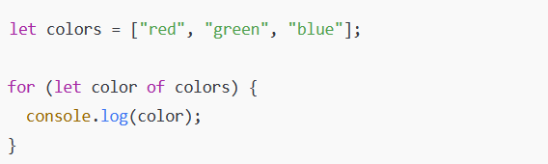
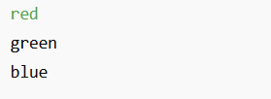
06
Loops
5.for...of loop
Used to loop through values of an iterable (like arrays, strings, Maps, Sets).

Slide 54
06
Loops
6. Loop Control Statements
Sometimes you need to control the flow inside loops:

Slide 55
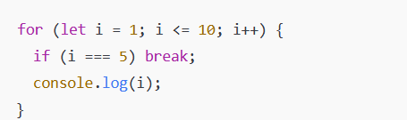
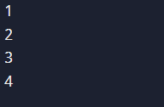
06
Loops
6. Loop Control Statements
1. break
Exits the loop immediately.

Slide 56
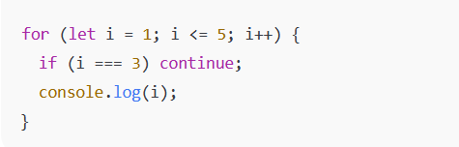
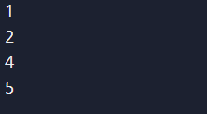
06
Loops
6. Loop Control Statements
2.continue
Skips the current iteration and goes to the next one.

Slide 57
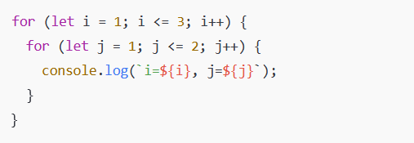

06
Loops
7. Nested Loops
Loop inside another loop.

Slide 58

wake up we're not done yet

Slide 59

06
Loops
Assignment
Easy Level

Slide 60

06
Loops
Assignment
Medium Level

Slide 61


06
Loops
Assignment
Medium Level

Slide 62

Any question ??

Slide 63

Conclusion

Slide 64
Thanks for your attention to us (^_^)
Have a Good weekend with the tasks o(≧∀≦)o

